Slide 1
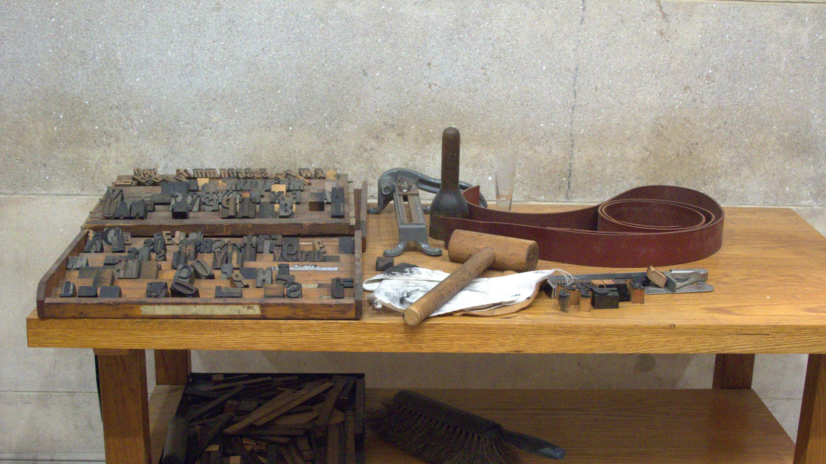
Class 12:
Script
Cryptocurrency Cabal
cs4501 Fall 2015
David Evans and Samee Zahur
University of Virginia

Slide 2
Plan for Today
Hash Collisions (Checkup 2 Revisions)
Bitcoin Script
Language
Transactions
Reminders
PS2 is due Friday at 8:29pm
Project Ideas
Midterm October 19
Monday: Guest lecture from Tom Dukes

Slide 3
Cryptographic Hash Desiderata
Pre-image resistance:
given a z, hard to find any x such that H(x) = z.
Collision resistance:
hard to find any pair of different values x, y
such that H(x) = H(y).
Efficient to compute (?)

Slide 4
Hash Functions in Bitcoin
A. Producing the public bitcoin address by hashing the public key.
B. Producing a transaction digest for use as the input in signing a transaction.
C. Producing the Merkle tree root for authenticating the transactions in a block (using hashes all the way up the tree).
D. Producing the hash of the previous block to use in the block header.
E. Producing the double hash of the block (with nonces) to find a block that satisfies the difficult needed in mining.

Slide 5
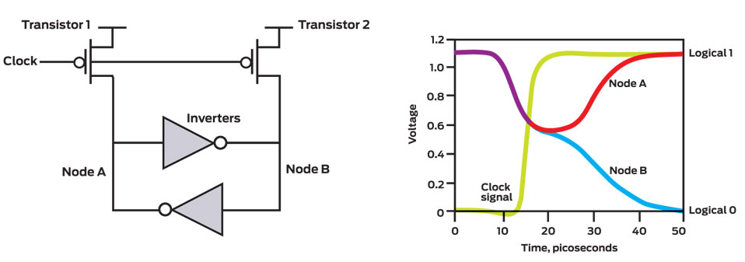
Generating a Bitcoin Address
Image: http://spectrum.ieee.org/computing/hardware/behind-intels-new-randomnumber-generator
256 random bits
generate random secret key k

Slide 6
Generating a Bitcoin Address
256 random bits
generate random secret key k
Compute point Gk on spec256k1 curve
G = 04 79BE667E F9DCBBAC 55A06295 CE870B07 029BFCDB 2DCE28D9 59F2815B 16F81798 483ADA77 26A3C465 5DA4FBFC 0E1108A8 FD17B448 A6855419 9C47D08F FB10D4B8
Ux
Uy

Slide 7
Generating a Bitcoin Address
256 random bits
generate random secret key k
Compute point Gk on spec256k1 curve
G = 04 79BE667E F9DCBBAC 55A06295 CE870B07 029BFCDB 2DCE28D9 59F2815B 16F81798 483ADA77 26A3C465 5DA4FBFC 0E1108A8 FD17B448 A6855419 9C47D08F FB10D4B8
Ux
Uy
RIPEMD160(SHA256(Ux || Uy))

Slide 8
256 random bits
generate random secret key k
Compute point Gk on spec256k1 curve
Ux
Uy
1
RIPEMD160(SHA256(Ux || Uy))
1
RIPEMD160(SHA256(Ux || Uy))
SHA256(SHA256( - ))
4 bytes
Base58 encoding (unambiguous printable characters)
Public Bitcoin Address

Slide 9
256 random bits
How dangerous are RIPEMD160 collisions?
generate random secret key k
Compute point Gk on spec256k1 curve
Ux
Uy
1
RIPEMD160(SHA256(Ux || Uy))
1
RIPEMD160(SHA256(Ux || Uy))
SHA256(SHA256( - ))
4 bytes
Base58 encoding (unambiguous printable characters)
Public Bitcoin Address

Slide 10
256 random bits
How dangerous are RIPEMD160 + SHA256 collisions?
generate random secret key k
Compute point Gk on spec256k1 curve
Ux
Uy
1
RIPEMD160(SHA256(Ux || Uy))
1
RIPEMD160(SHA256(Ux || Uy))
SHA256(SHA256( - ))
4 bytes
Base58 encoding (unambiguous printable characters)
Public Bitcoin Address

Slide 11
256 random bits
How dangerous are RIPEMD160 + SHA256 pre-image break?
generate random secret key k
Compute point Gk on spec256k1 curve
Ux
Uy
1
RIPEMD160(SHA256(Ux || Uy))
1
RIPEMD160(SHA256(Ux || Uy))
SHA256(SHA256( - ))
4 bytes
Base58 encoding (unambiguous printable characters)
Public Bitcoin Address

Slide 12
Is there anywhere a SHA-256 collision break would be exploitable?
A. Producing the public bitcoin address by hashing the public key.
B. Producing a transaction digest for use as the input in signing a transaction.
C. Producing the Merkle tree root for authenticating the transactions in a block (using hashes all the way up the tree).
D. Producing the hash of the previous block to use in the block header.
E. Producing the double hash of the block (with nonces) to find a block that satisfies the difficult needed in mining.

Slide 13
Is there anywhere a SHA-256 pre-image break would be exploitable?
A. Producing the public bitcoin address by hashing the public key.
B. Producing a transaction digest for use as the input in signing a transaction.
C. Producing the Merkle tree root for authenticating the transactions in a block (using hashes all the way up the tree).
D. Producing the hash of the previous block to use in the block header.
E. Producing the double hash of the block (with nonces) to find a block that satisfies the difficult needed in mining.

Slide 14
SHA-256 Collisions?
Do there exist two different values, x and y, such that:
SHA256(x) = SHA256(y)

Slide 15
SHA-256 Collisions?
Do there exist two different values, x and y, such that:
SHA256(x) = SHA256(y)
Recall birthday attack: probability of finding collision negligible with less than 2¹²⁸ inputs.

Slide 16
SHA-256 Collisions?
Do there exist two different values, x and y, such that:
SHA256(x) = SHA256(y)
Does anyone actually know such values today?

Slide 17
What about RIPEMD160?
Do there exist two different values, x and y, such that:
RIPEMD160(x) = RIPEMD160(y)
Does anyone actually know such values today?

Slide 18
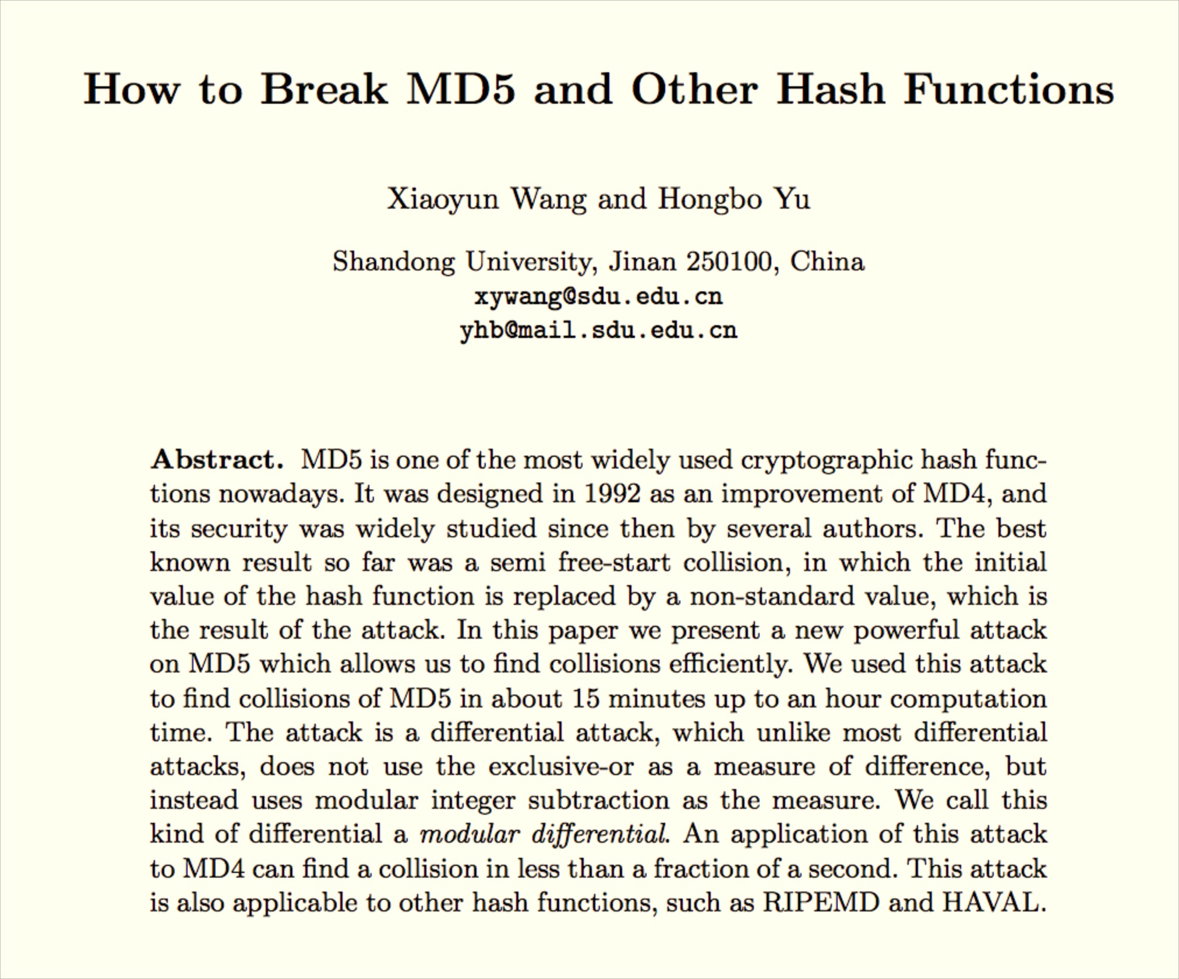
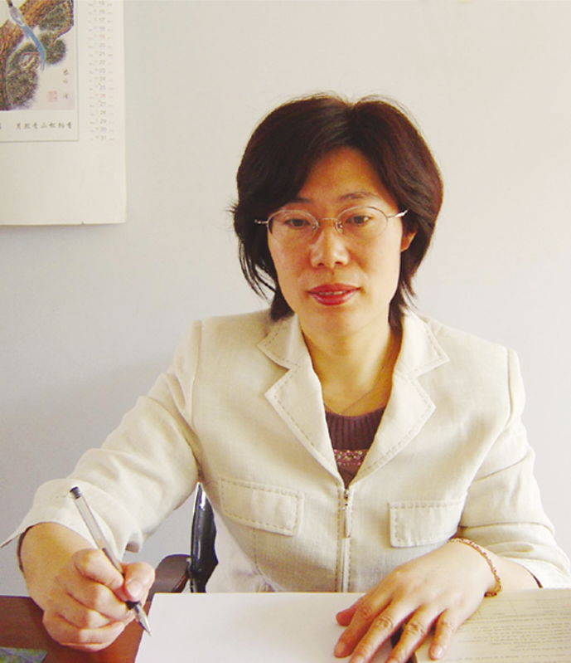
Xiaoyun Wang

Slide 19
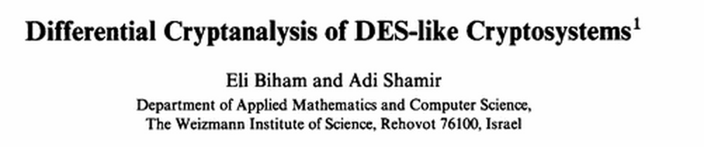
Differential Cryptanalysis
Discovered openly
in 1991

Slide 20
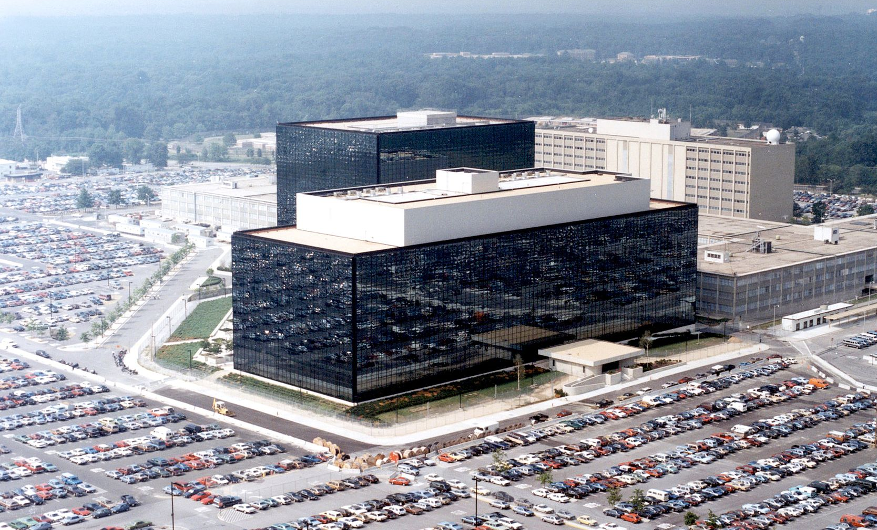
Differential Cryptanalysis
Discovered openly
in 1991
Known secretly to IBM and NSA in 1974
(DES design strengthened against it)

Slide 21
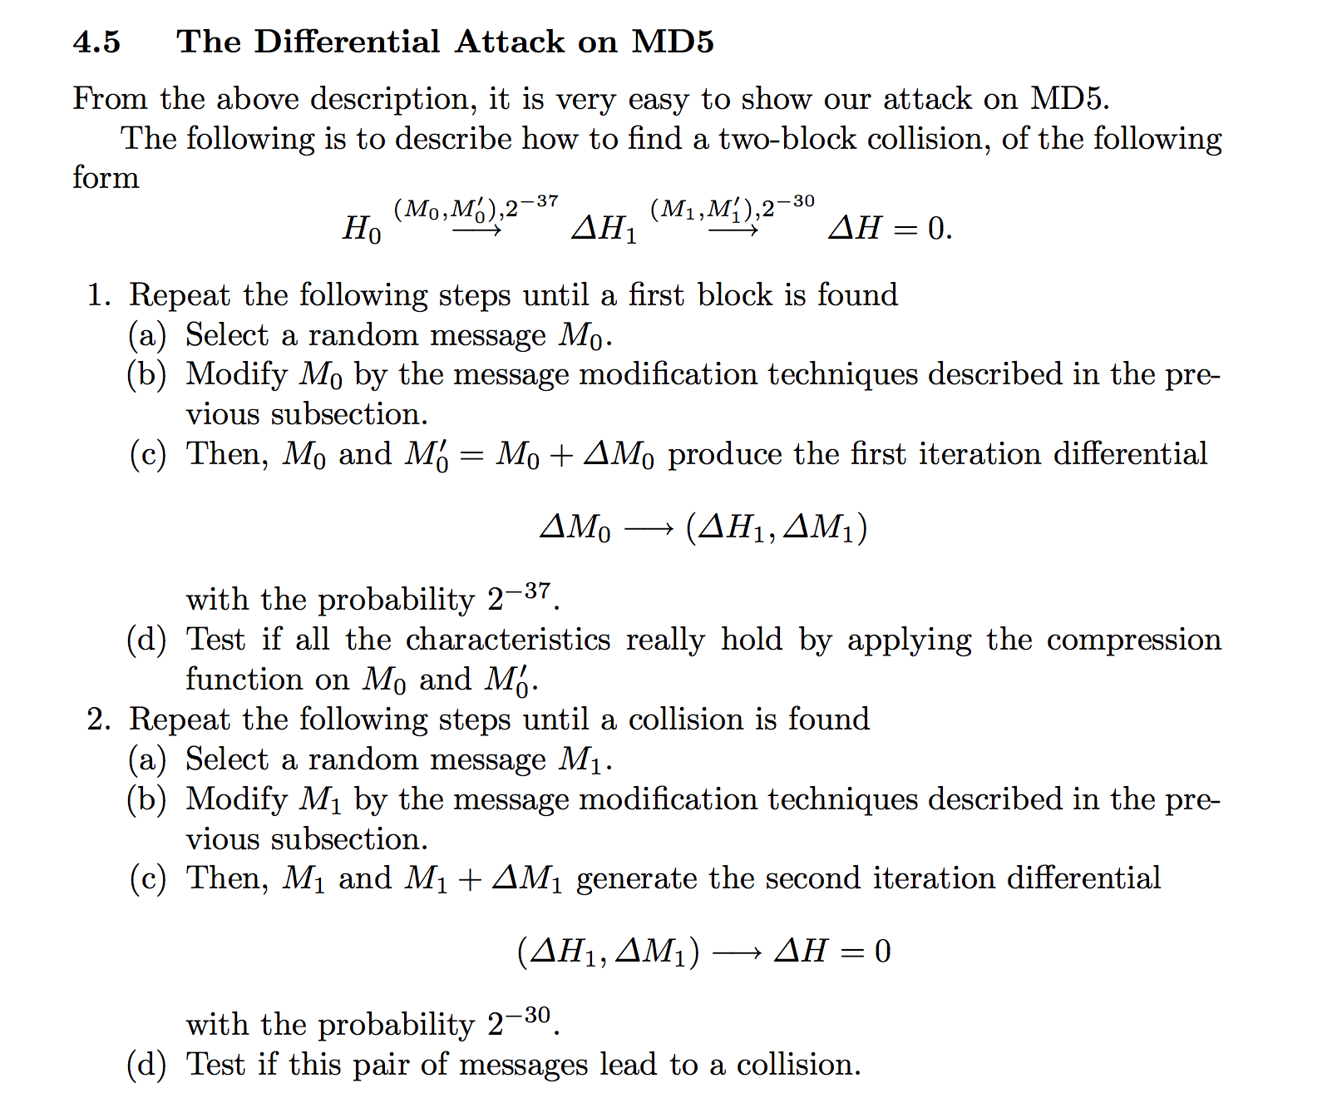
Differential Cryptanalysis

Slide 22
How worried should we be about SHA-256?

Slide 23
How worried should we be about SHA-256?
Best known collision attacks: work on reduced round version (31 instead of 64 rounds) and have high complexity (2⁶⁵ instead of 2¹²⁸)

Slide 24
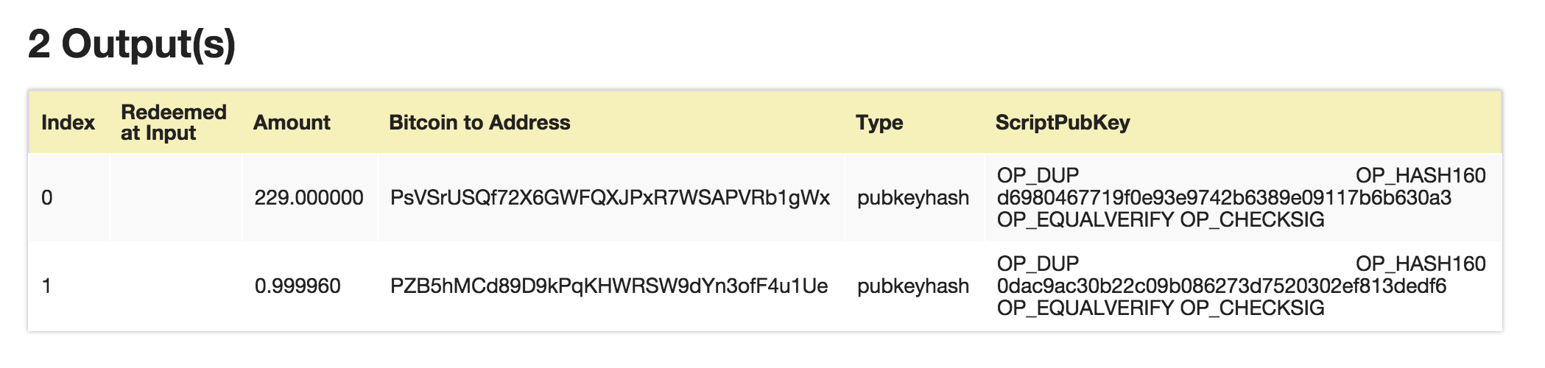
Bitcoin Transactions
http://blockexplorer.bitcoin-class.org/rawtx/f2d90b4ee862c328f42fb24ca5a84051a495af1de0f8d129a5b33cd98822719a
Transaction outputs include programs written in “Script”

Slide 25
Script Language
Stack-based (similar to JVML)
~80 opcodes (many have been deprecated)
Late addition to bitcoin design
Lots of limitations in what nodes will accept: altcoins are taking different approaches

Slide 26
Interpreting Script
OP_1
OP_DUP
OP_ADD
OP_DUP
OP_SUB
OP_VERIFY

Slide 27
Is Script Turing-Complete?

Slide 28
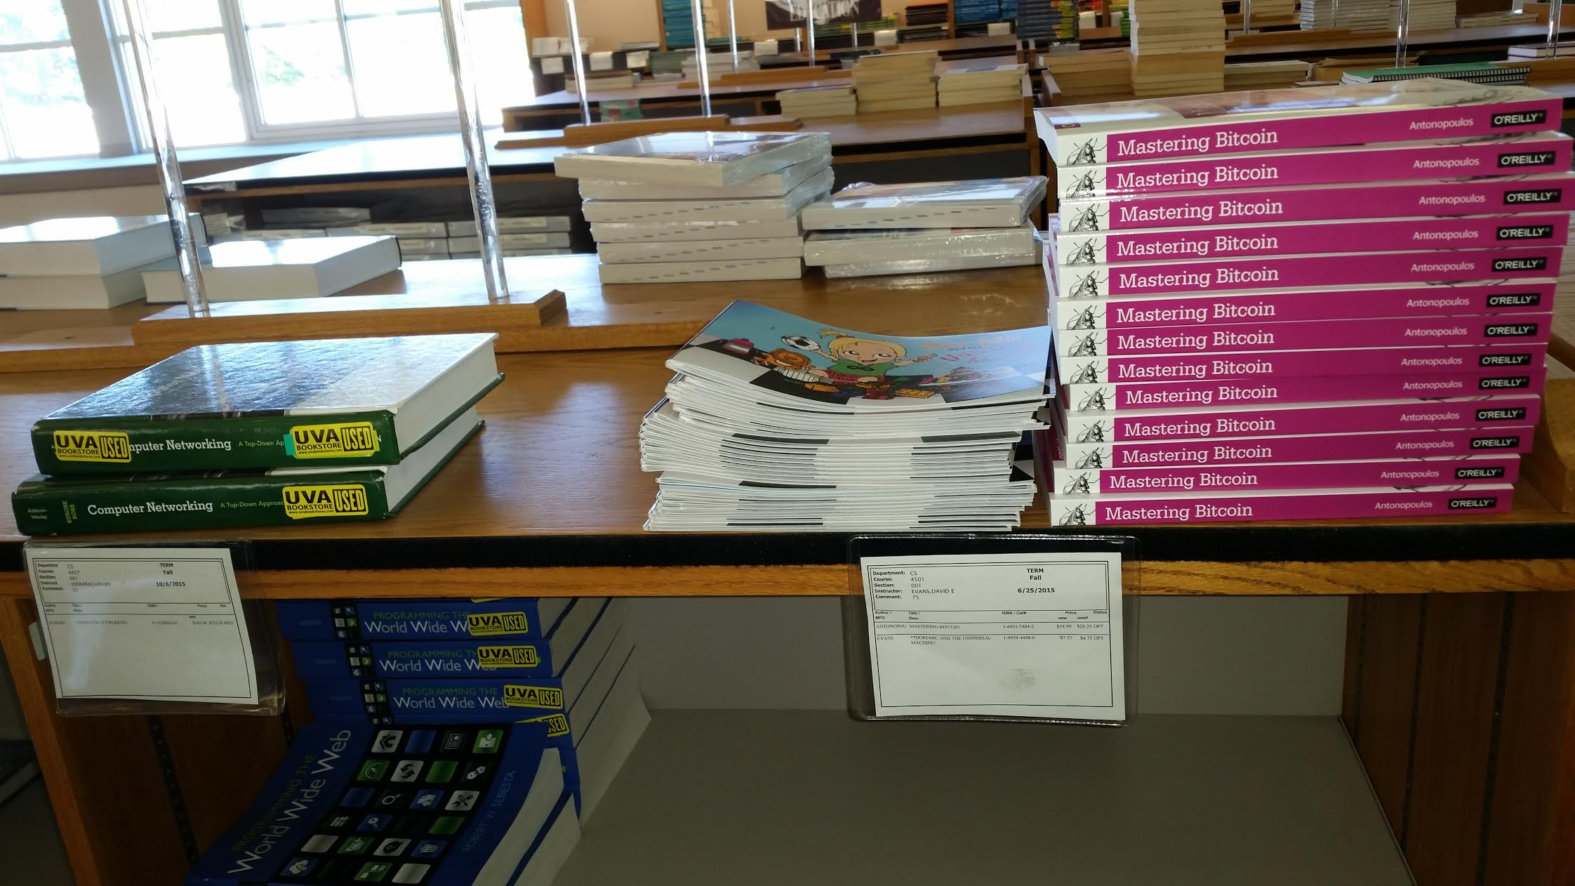

Slide 29
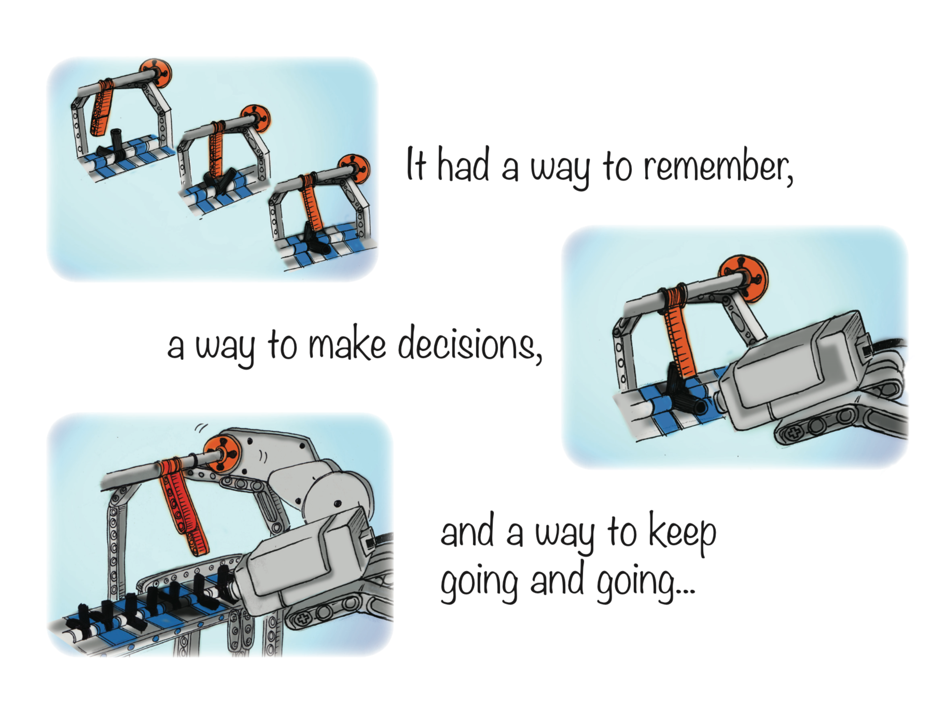
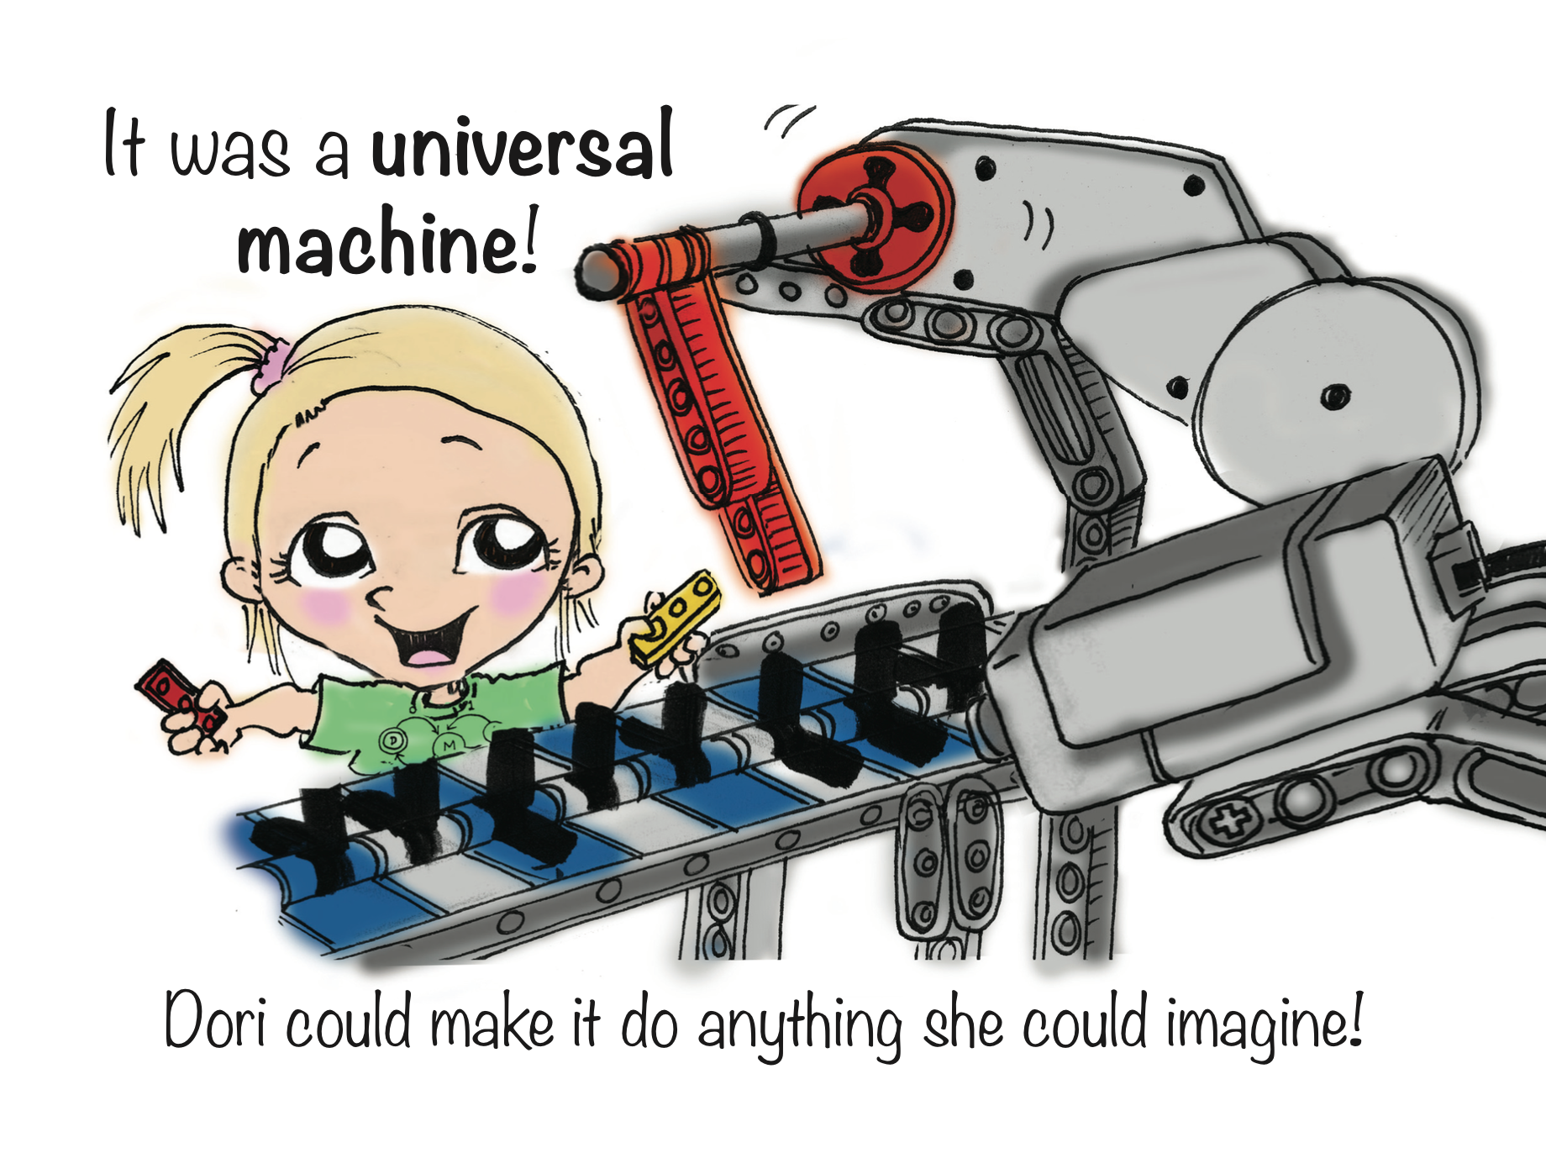

Slide 30
Interpreting Script

Slide 31
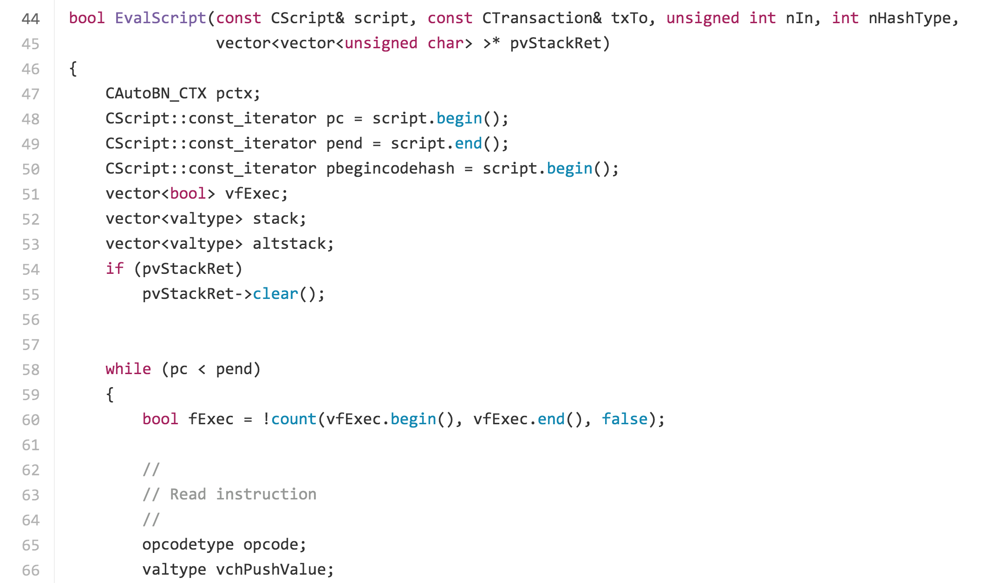
https://github.com/bitcoin/bitcoin/blob/v0.1.5/script.cpp#L41

Slide 32
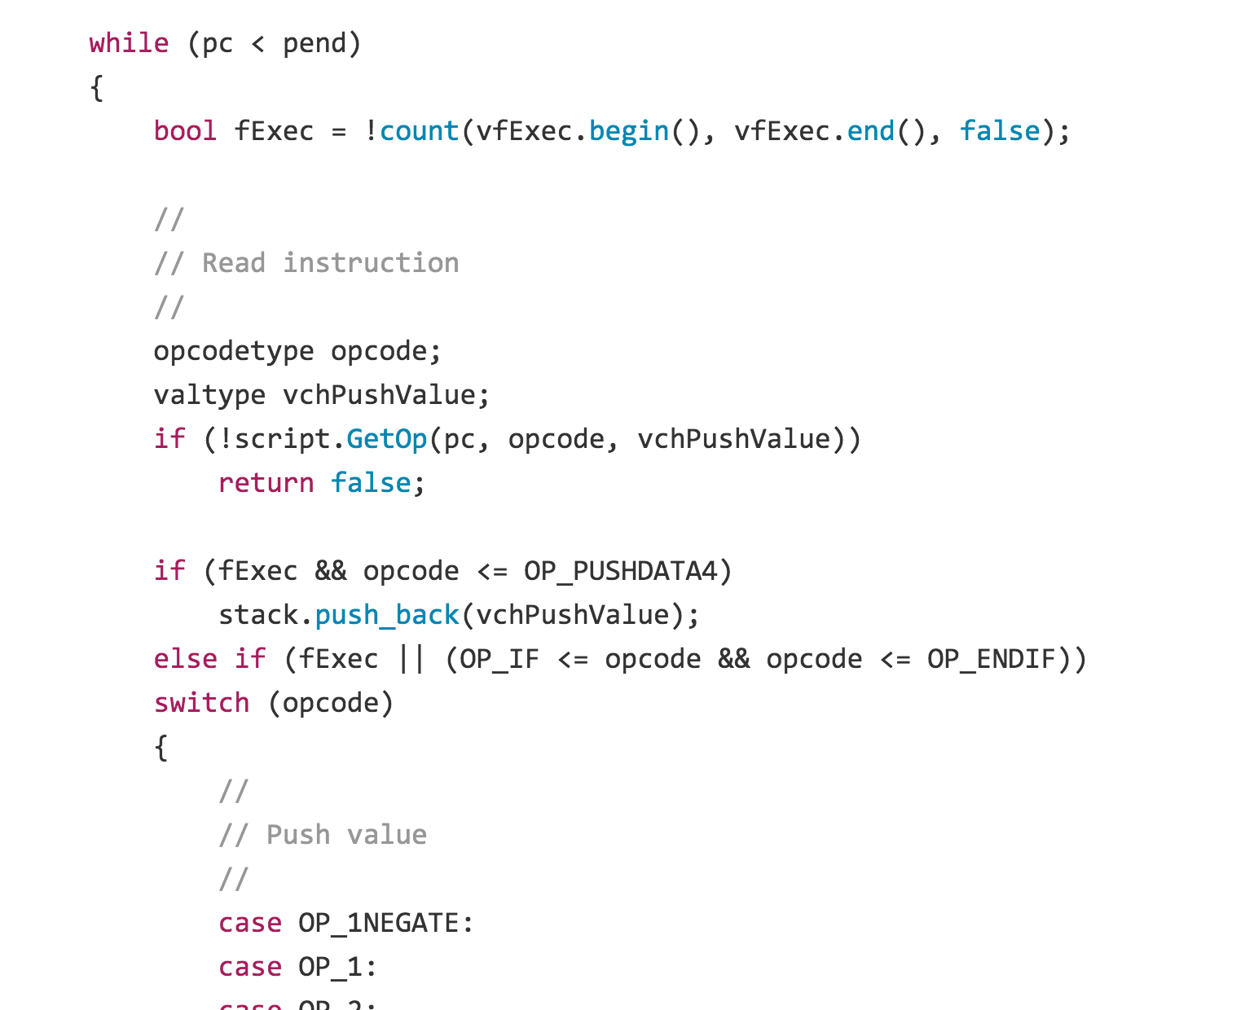
https://github.com/bitcoin/bitcoin/blob/v0.1.5/script.cpp#L58

Slide 33
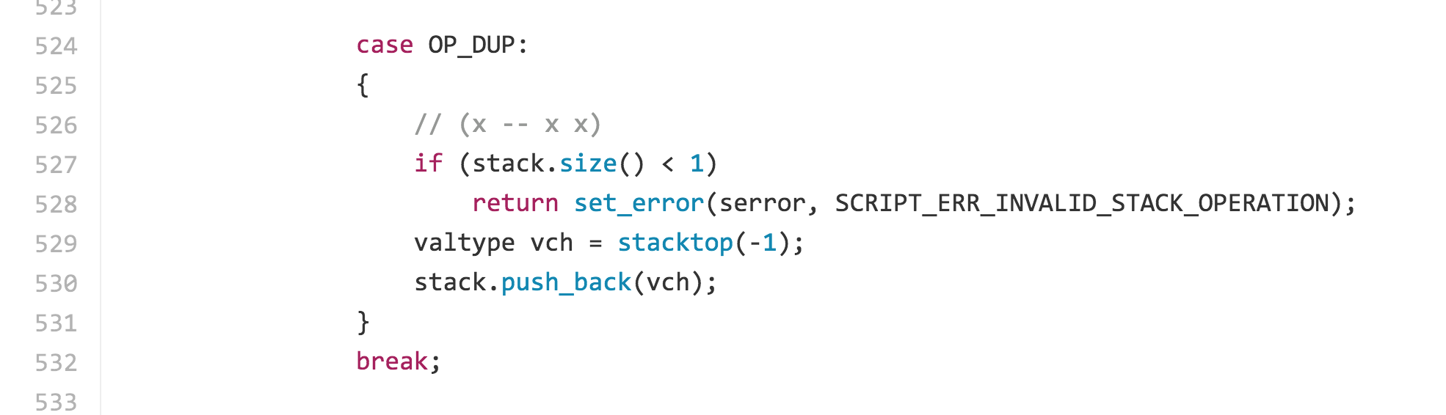
Interpreting Script
https://github.com/bitcoin/bitcoin/blob/41e6e4caba9899ce7c165b0784461c55c867ee24/src/script/interpreter.cpp#L524

Slide 34
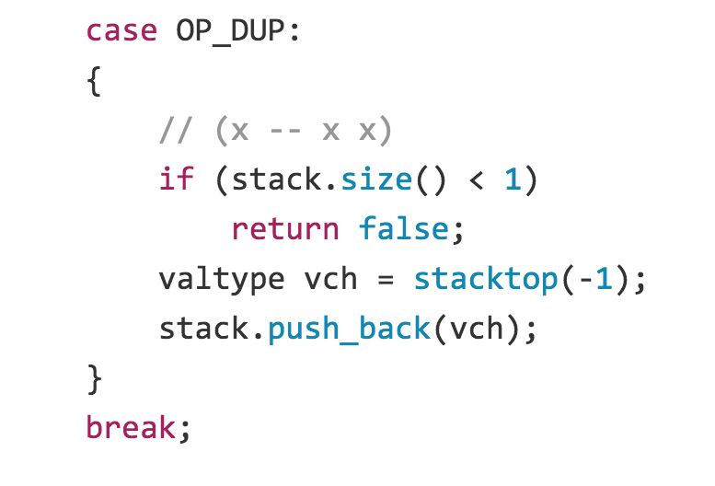
https://github.com/bitcoin/bitcoin/blob/41e6e4caba9899ce7c165b0784461c55c867ee24/src/script/interpreter.cpp#L524
Latest
Version 0.1
Project idea: look at how bitcoin core code has evolved over time

Slide 35
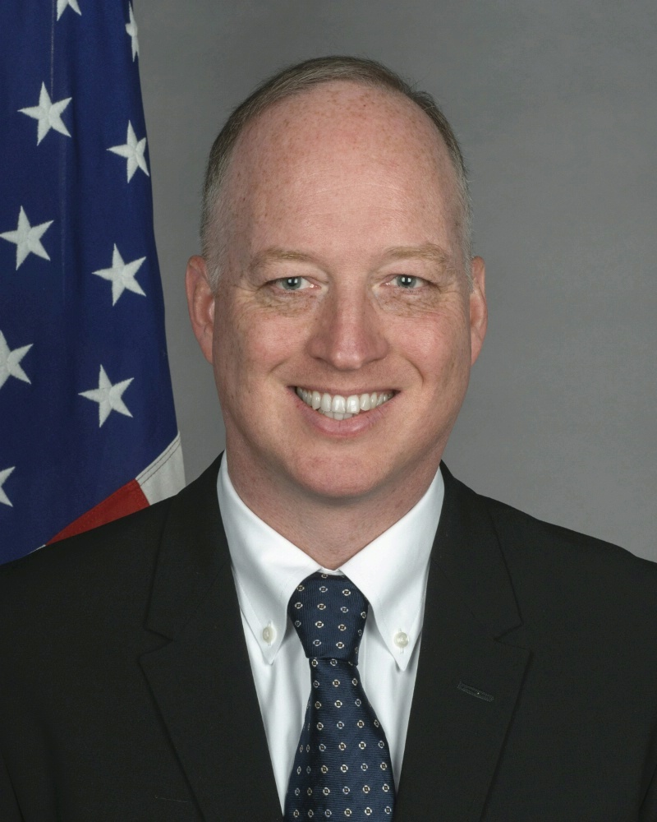
Charge
PS2 Due Friday
Monday’s class:
Tom Dukes
UVa Cyberlaw
State Department
Tom Dukes

